Slide 1
External Sorting
Adapt fastest internal-sort methods.
Quick sort …best average run time.
Merge sort … best worst-case run time.
Notes:
Adaptation of quicksort exposed the need for data structures for double-ended priority queues; concept of buffers (portions of memory to read into and write from); and buffer management to reduce time spent waiting for a buffer to empty or fill to/from disk.

Slide 2
Internal Merge Sort Review
Phase 1
  Create initial sorted segments
    Natural segments
    Insertion sort
Phase 2
  Merge pairs of sorted segments, in merge passes, until only 1 segment remains.

Slide 3
External Merge Sort
Block size is 100 records.
Sort n=10,000 records. (100 blocks)
Enough memory for 500 records. (5 blocks)
共20個blocks要排序 (每個block內的資料已經事先排好次序)
以block為單位探討
  t_{IO} = time to input/output 1 block
  (includes seek, latency, and transmission times)
  t_{IS} = time to internally sort 1 memory load
  t_{IM} = time to internally merge 1 block load

Slide 4
External Merge Sort
Two phases.
  Run generation.
    A run is a sorted sequence of records.
  Run merging.
Notes:
Iterative internal merge sort starts with sorted segments; performs merge passes in each of which the number of sorted segments becomes half; stops when we have just one sorted segment. The sorted segments may be created using insertion sort say to get initial segments of size 15 (say).

Slide 5
Run Generation (100 records/block)
10,000 records
100 blocks
MEMORY
500 records
5 blocks
DISK
Input 5 blocks.
Sort.
Output as a run.
Do 20 times.
5t_{IO}
t_{IS}
5t_{IO}
200t_{IO} + 20t_{IS}

Slide 6
Run Merging
Merge Pass.
  Pairwise merge the 20 runs into 10.
  In a merge pass all runs (except possibly one) are pairwise merged.
Perform 4+ merge passes (i.e., 5), reducing the number of runs to 1.

Slide 7
Merge 20 Runs
每一個run有5 blocks
R1
R2
R3
R4
R5
R6
R7
R8
R9
R10
R11
R12
R13
R14
R15
R16
R17
R18
R19
R20
S1
S2
S3
S4
S5
S6
S7
S8
S9
S10
T1
T2
T3
T4
T5
U2
U3
U1
V1
V2
W1

Slide 8
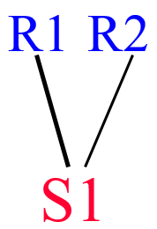
Merge R1 and R2
Output
Input 0
Input 1
DISK
Fill I0 (Input 0) from R1 and I1 from R2.
Merge from I0 and I1 to output buffer.
Write whenever output buffer full.
Read whenever input buffer empty.

Slide 9
Time To Merge R1 and R2
Each is 5 blocks long.
Input time = 10t_{IO}. //正比於資料量
Merge time = 10t_{IM}. //正比於資料量
Write/output time = 10t_{IO}. //正比於資料量
Total time = 20t_{IO} + 10t_{IM} .
5 blocks
5 blocks
10 blocks

Slide 10
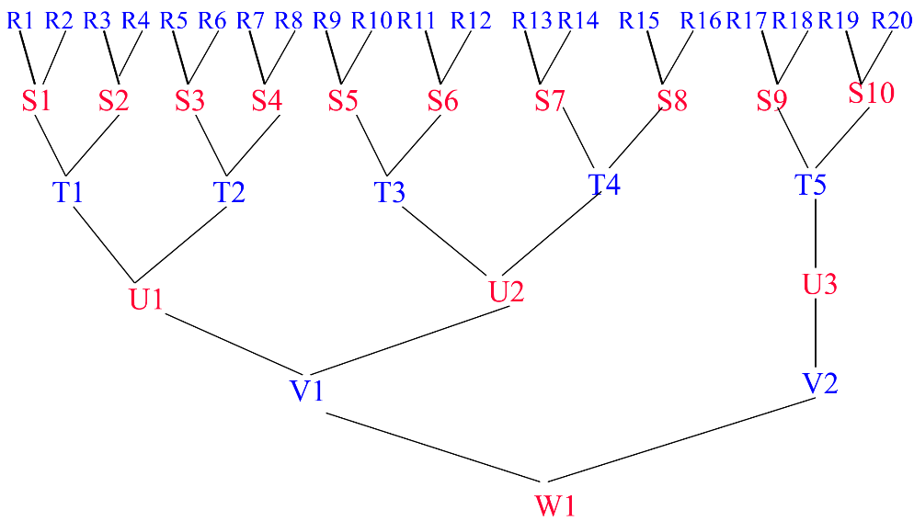
Time For Pass 1 (R S)
Time to merge one pair of runs = 20t_{IO} + 10t_{IM} .
Time to merge all 10 pairs of runs = 200t_{IO} + 100t_{IM} .

Slide 11
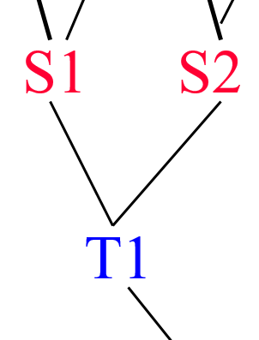
Time To Merge S1 and S2
Each is 10 blocks long.
Input time = 20t_{IO}.
Write/output time = 20t_{IO}.
Merge time = 20t_{IM}.
Total time = 40t_{IO} + 20t_{IM} .
10 blocks
10 blocks
20 blocks

Slide 12
Time For Pass 2 (S T)
Time to merge one pair of runs = 40t_{IO} + 20t_{IM} .
Time to merge all 5 pairs of runs = 200t_{IO} + 100t_{IM} .
10 blocks
10 blocks
20 blocks

Slide 13
Time For One Merge Pass
Time to input all blocks = 100t_{IO}.
Time to output all blocks = 100t_{IO}.
Time to merge all blocks = 100t_{IM} .
Total time for a merge pass = 200t_{IO} + 100t_{IM} .
200t_{IO} + 100t_{IM} (one merge pass)
200t_{IO} + 100t_{IM} (one merge pass)

Slide 14
Total Run-Merging Time
(time for one merge pass) * (number of passes)
= (time for one merge pass)
  * ceil(log₂(number of initial runs))
= (200t_{IO} + 100t_{IM}) * ceil(log₂(20))
= (200t_{IO} + 100t_{IM}) * 5

Slide 15
Factors in Overall Run Time
Run generation. 200t_{IO} + 20t_{IS}
  Internal sort time.
  Input and output time.
Run merging. (200t_{IO} + 100t_{IM}) * ceil(log₂(20))
  Internal merge time.
  Input and output time.
  Number of initial runs.
  Number of merge passes
20 blocks

Slide 16
Improve Run Generation
  Overlap input, output, and internal sorting.
DISK
MEMORY
DISK

Slide 17
Improve Run Generation
Generate runs whose length (on average) exceeds memory size.
Equivalent to reducing number of runs generated.

Slide 18
Improve Run Merging
  Overlap input, output, and internal merging.
DISK
MEMORY
DISK

Slide 19
Improve Run Merging
Reduce number of merge passes.
  Use higher-order merge.
  Number of passes = ceil(log_{k}(number of initial runs)) where k is the merge order.

Slide 20
Merge 20 Runs Using 5-Way Merging
R1
R2
R3
R4
R5
R6
R7
R8
R9
R10
R11
R12
R13
R14
R15
R16
R17
R18
R19
R20
S1
S2
S3
S4
T1
Number of passes = 2

Slide 21
I/O Time Per Merge Pass
Number of input buffers needed is linear in merge order k.
Since memory size is fixed, block size decreases as k increases (after a certain k).
So, number of blocks increases.
So, number of seek and latency delays per pass increases.

Slide 22
Total I/O Time To Merge Runs
(I/O time for one merge pass) * ceil(log_{k}(number of initial runs))
k不容易決定:
k變大雖然passes變少，
但每次pass的 IO時間的次數變多因而時間變長
Total I/O time to merge runs
merge order k

Slide 23
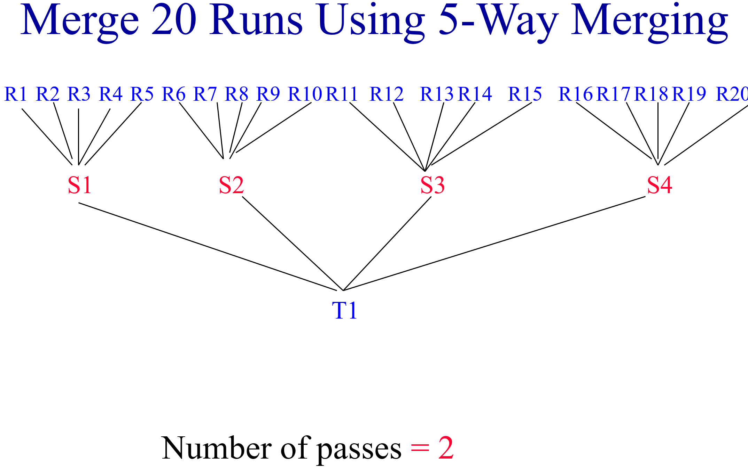
Internal Merge Time
O
R1
R2
R3
R4
R5
R6
Naïve way => k – 1 compares to determine next record to move to the output buffer.
Time to merge n records (one pass) is c(k – 1)n, where c is a constant.
Merge time per pass is c(k – 1)n.
Total merge time is c(k – 1)nlog_{k}r ∼ cn(k/log₂k) log₂r.

Slide 24
Merge Time Using A Selection Tree
O
R1
R2
R3
R4
R5
R6
Time to merge n records is dnlog₂k, where d is a constant.
  One pass contains n records
Merge time per pass is dnlog₂k.
Total merge time is (dnlog₂k) log_{k}r = dnlog₂r.
當k大時，k的影響就不會影響執行時間

